Slide 1
Car previewer
Structured programming project
Done by: program : AIE
Reem Mahmoud bekhit
Ahmed Mohamed abdelazim
Amro khaled momtaz
Omar Mohamed ali
Mahmoud hesham hassan

Slide 2
AIM
Our aim is to inform the user of the price of his car when they sell it as easily as possible without making the user get out of his house+ by getting some information about the car from the user.
Information like the model of the car, its year, how many kilometers did the car move… etc.

Slide 3
Future of this job
After 5 to 10 years this job is going to be changed to robotical employment system and these robots are going to be programmed by a number of computer engineers
So our group programmed a demo of this future project and it will be showed to you in a moment and in this project we used a bunch of c++ functions and variables that may help us in introducing this project to you in the best way

Slide 4
Car previewer
Car previewer is a program that we can use to check the price of the car that we bought a couple of years a go when we are going to sell it.
The price will be estimated due to many factors and we will be showing these factors in the next slide

Slide 5
Price estimation:
The car’s price estimation will be done after considering :
1- The year of the car’s model
2-The distance that was driven by the car
3- if there were past accidents taken by the car

Slide 6
The car’s model year
The more the car gets older the more the price will decrease depending on the years it was used in.
the estimation will be calculated using this equation:
(1 -percentage year/100) *( (years) * main price))

Slide 7
The distance that was driven by the car
The more the kilometers driven by the car the less the estimation of the price will become because it means that the car parts were consumed in usage by the owner which causes the car’s life span become less
But if it was used in a life span of 4 years it means it was used as if it was new
This will make the price estimation to become very high which means getting a higher profit from the car

Slide 8
Accidents and the type of t accidents
If there an accident take by the car that will make the price drop depending on the number of the accidents taken:
If the accident was very bad then the car price will drop by a huge amount
And also depending on the number of accidents taken it will be considered by the previewer

Slide 9
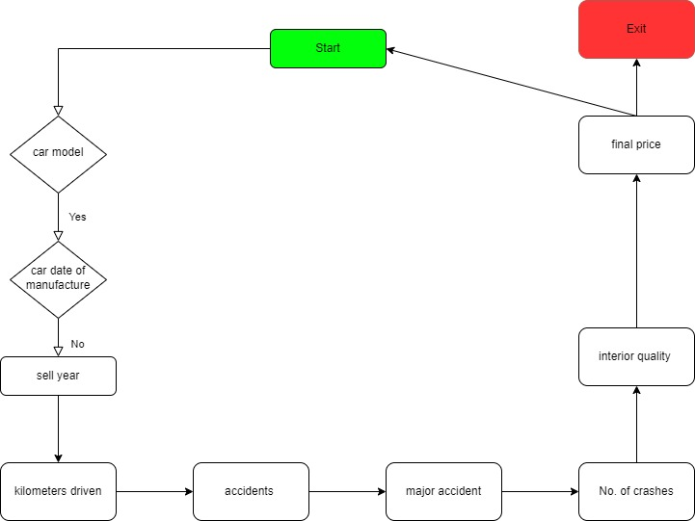
Flow Chart

Slide 10
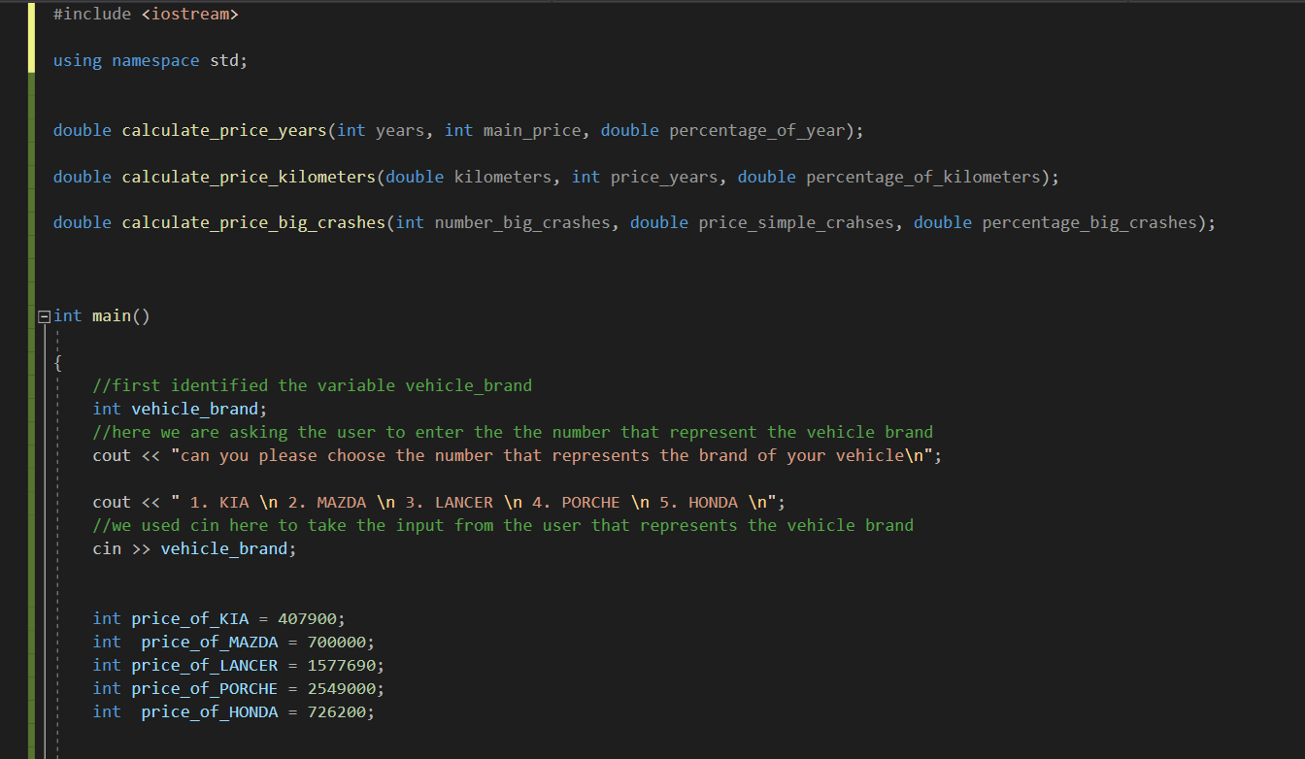
CODE

Slide 11
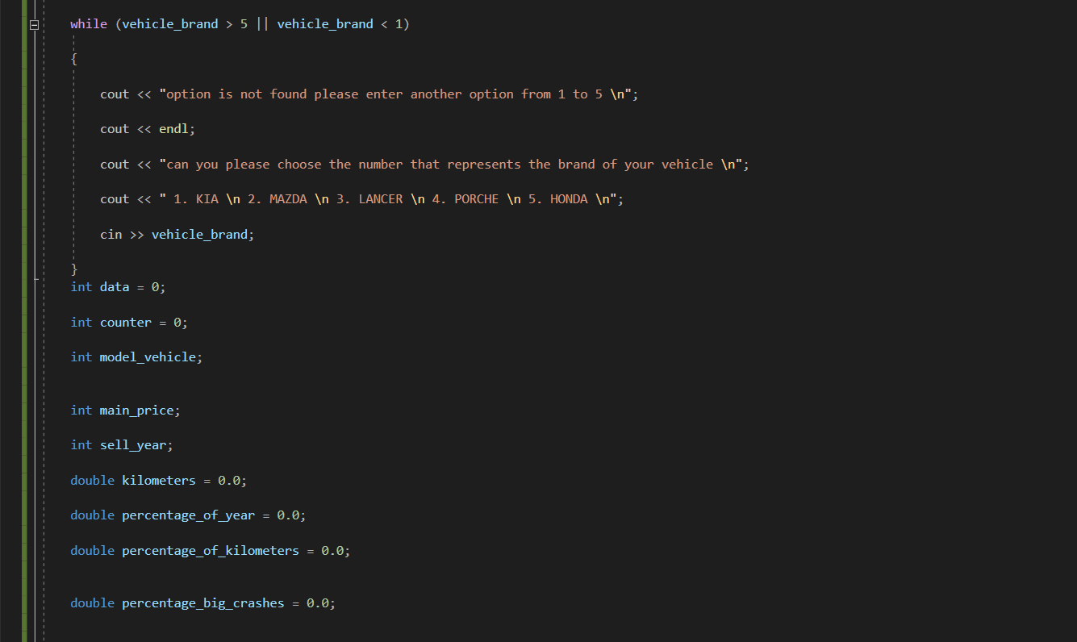
CODE

Slide 12
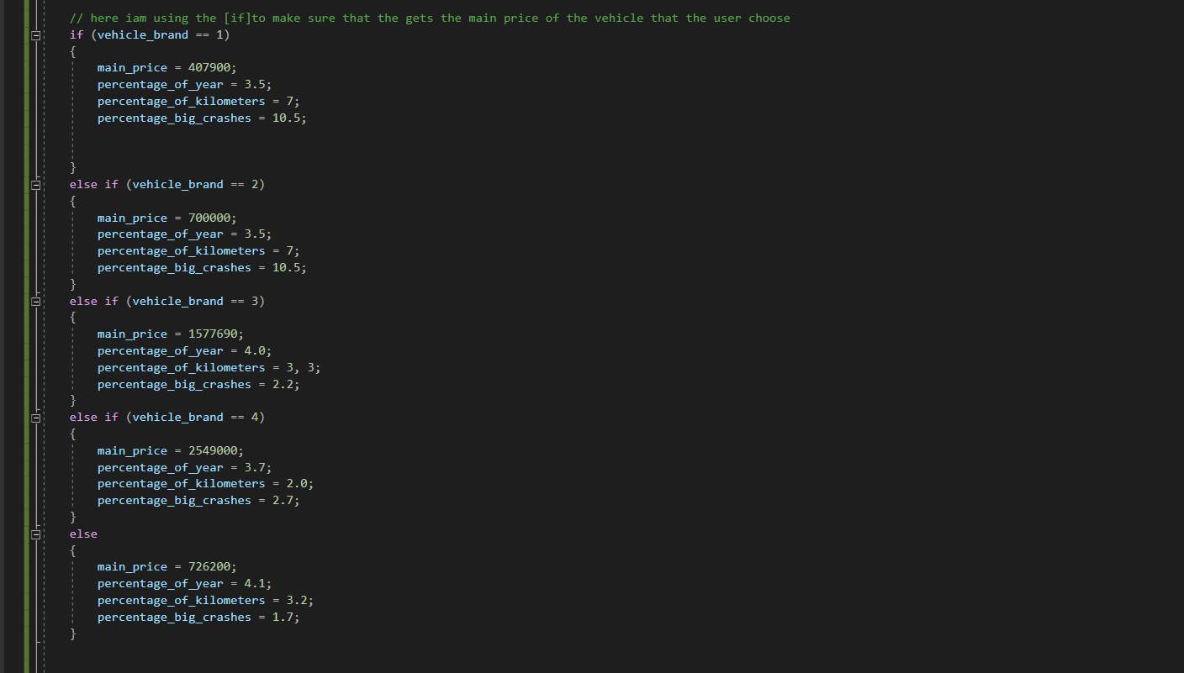
CODE

Slide 13
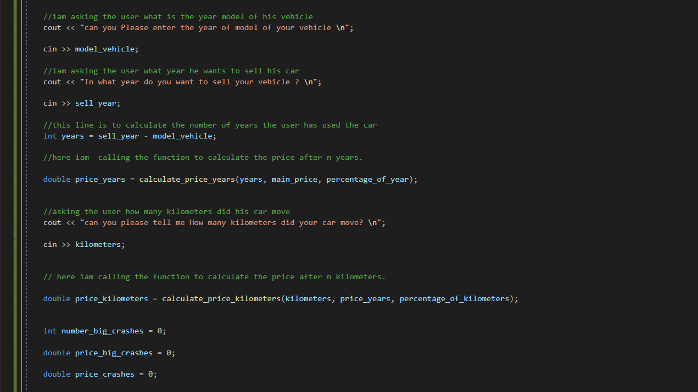
CODE

Slide 14
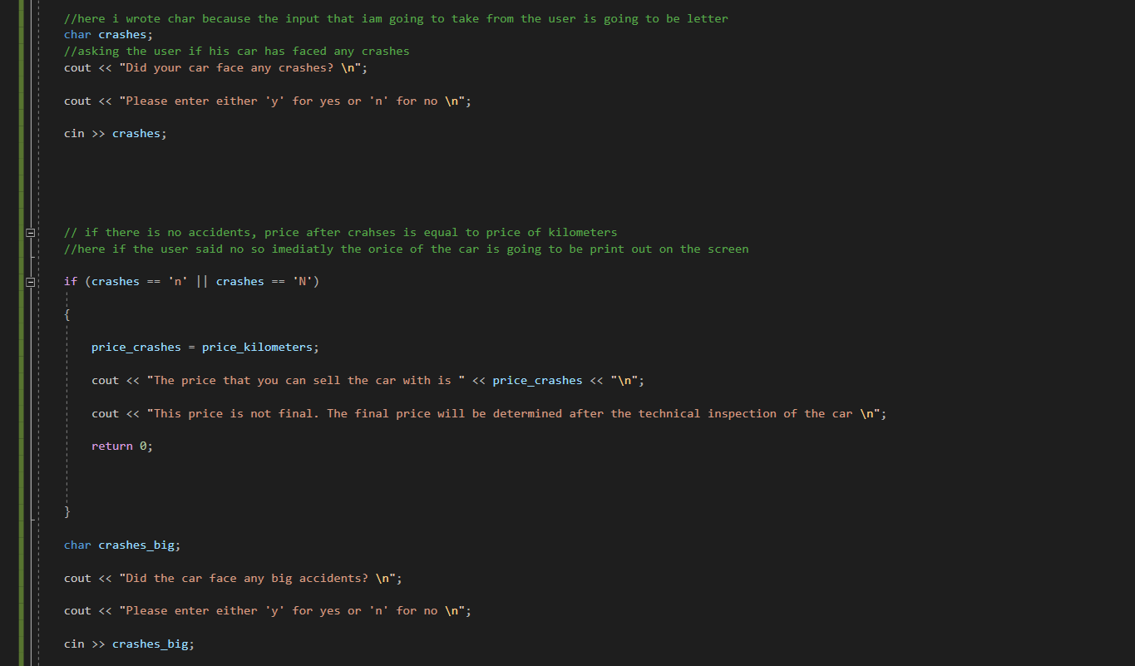
CODE

Slide 15
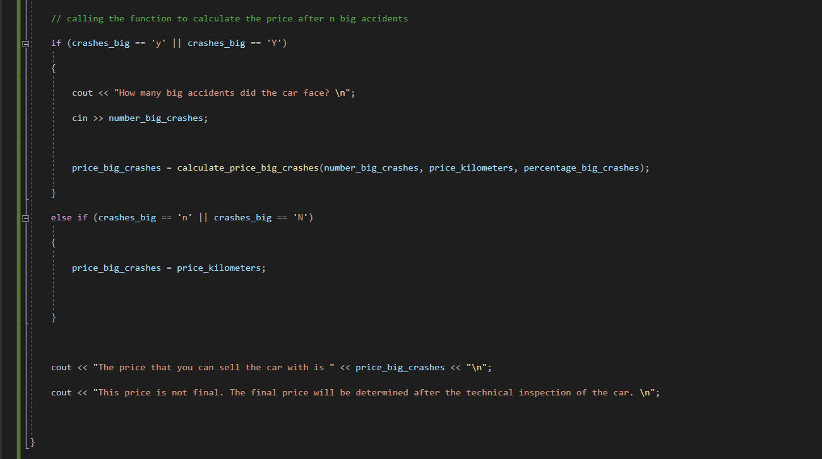
CODE

Slide 16
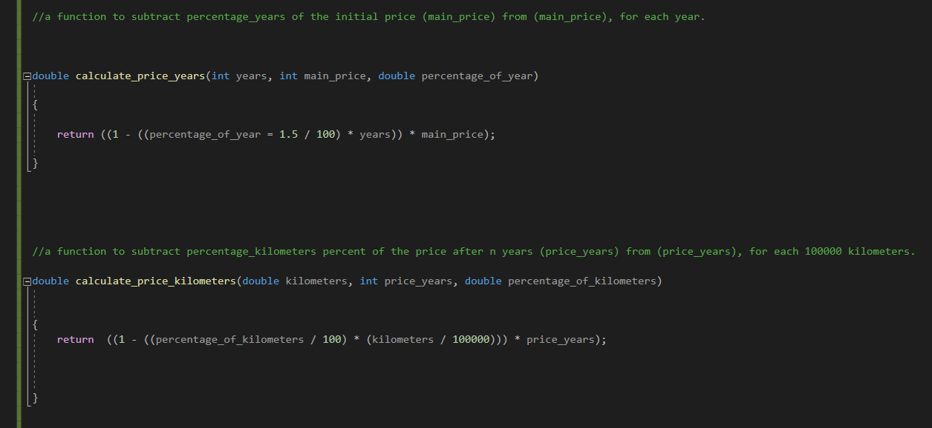
CODE

Slide 17
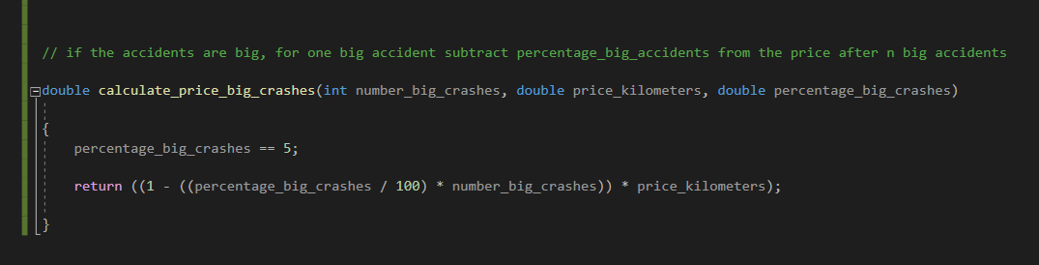
CODE

Slide 18
Conclusion
Finally, this tool makes calculating the final selling price of a car more fugacious and simple for the user.
We hope in the near future to:
introduce more car brands and models in the near future.
to restrict the user's year selection.

Slide 19
Thank you for listening!

